Slide 1

Resilient and Scalable Web Application Deployment on AWS
PAVNEET THIND
Manipal University,Jaipur

Slide 2
Description
This project involves designing and implementing a highly available and scalable web application infrastructure on AWS
The architecture will leverage AWS services to ensure
1.Fault Tolerance
2. Load balancing
3. Secure user access
The core of the project is to deploy a web application that can handle varying loads efficiently and maintain high availability across multiple Availability Zones (AZs).

Slide 3

Objective and scope
High Availability: Achieve minimal downtime for the web application by utilizing multiple Availability Zones.
Scalability: Use AWS Auto Scaling to adjust resources automatically in response to traffic changes, ensuring efficient performance.
Security: Implement security measures focusing on security groups and secure communication.
Resilience: Develop a resilient application setup that can withstand failures and traffic spikes without manual intervention.

Slide 4
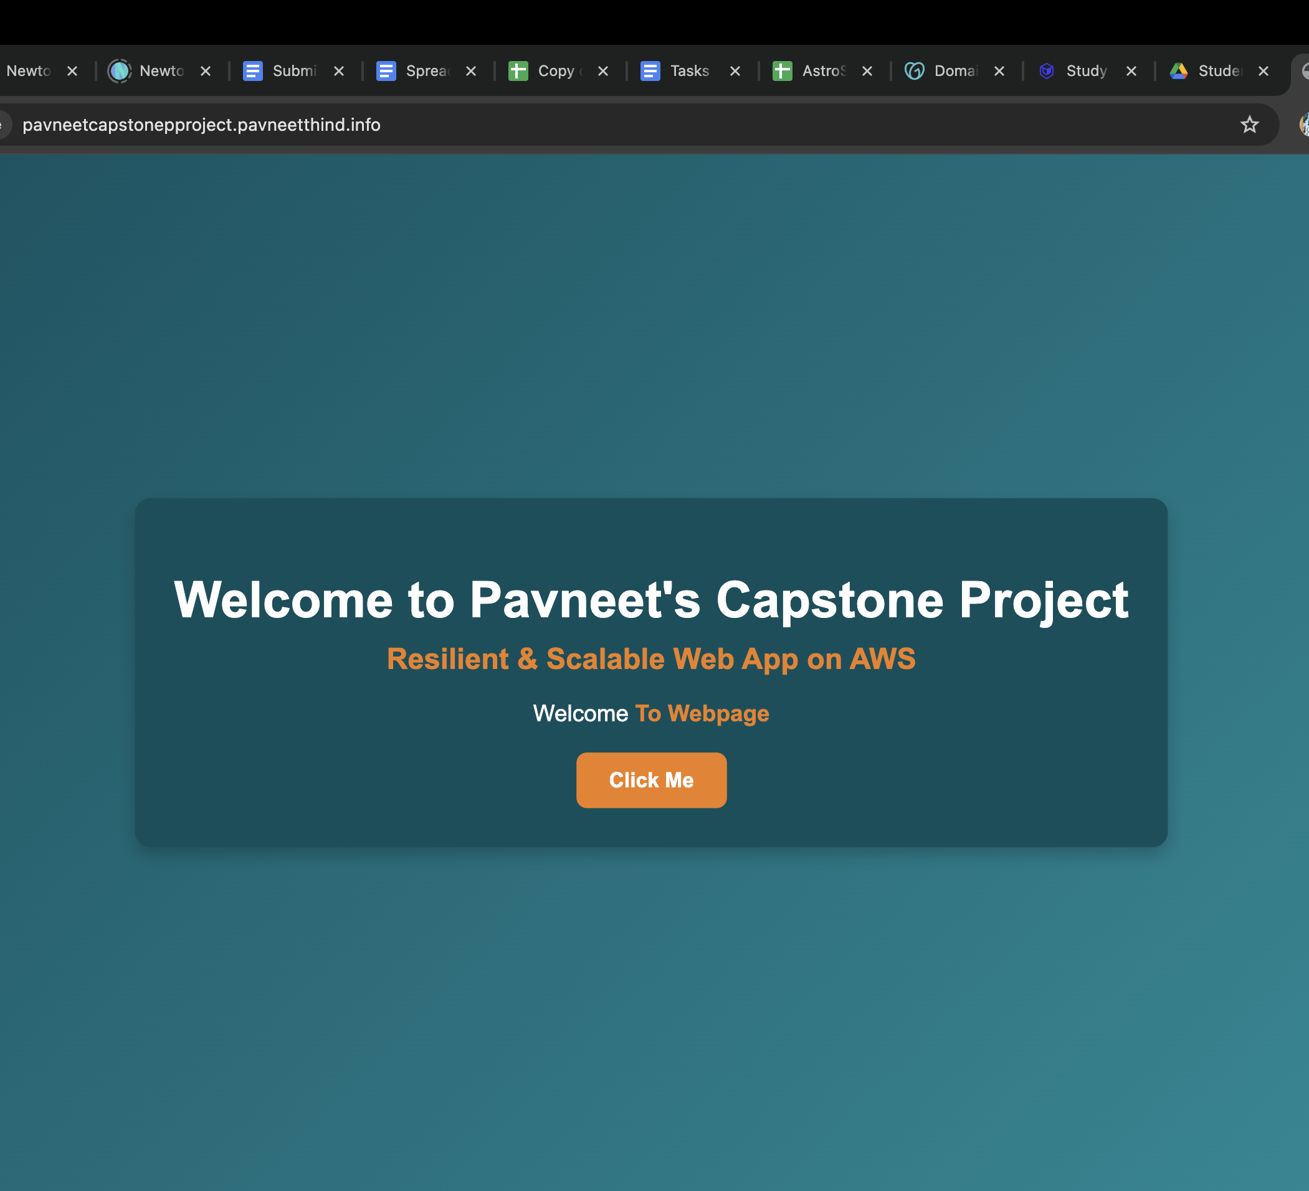
WEB APPLICATION HOSTING

Slide 5
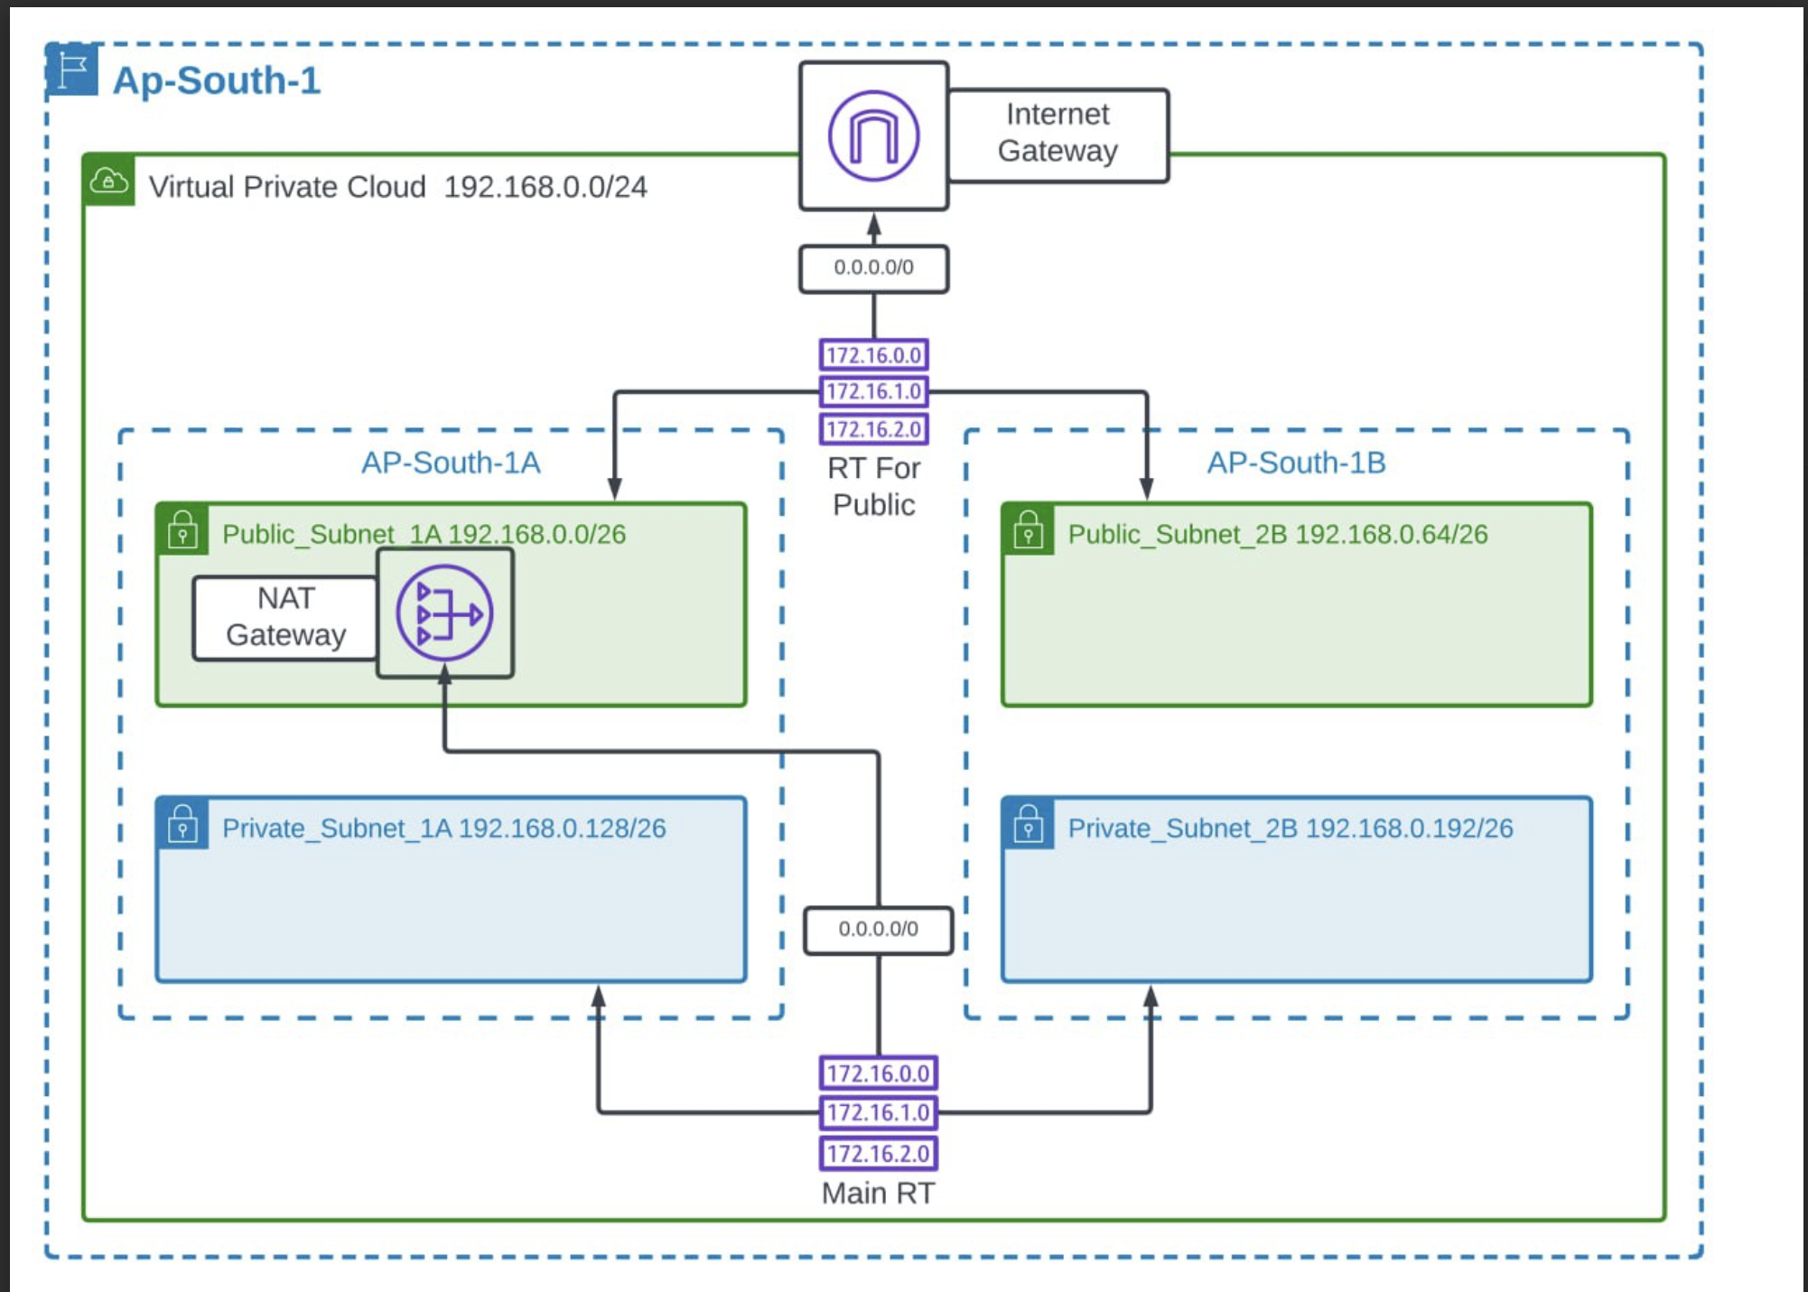
Core AWS Services Utilization
Virtual Private Cloud (VPC): Set up a custom VPC to provide a isolated network environment. This VPC will have public and private subnets across different AZs for enhanced security and availability.

Slide 6
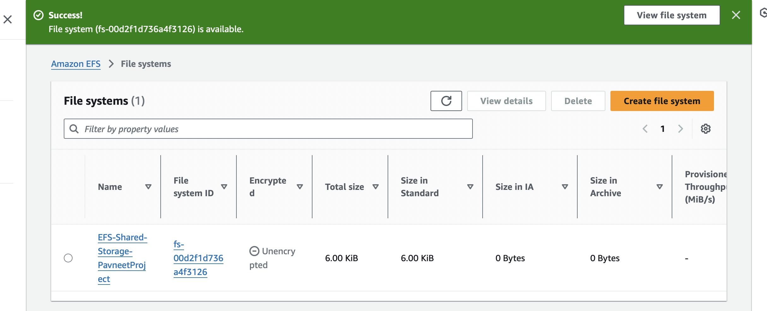
Elastic File System (EFS): Leverage EFS for scalable file storage, which can be concurrently accessed by instances for storing shared application data.

Slide 7
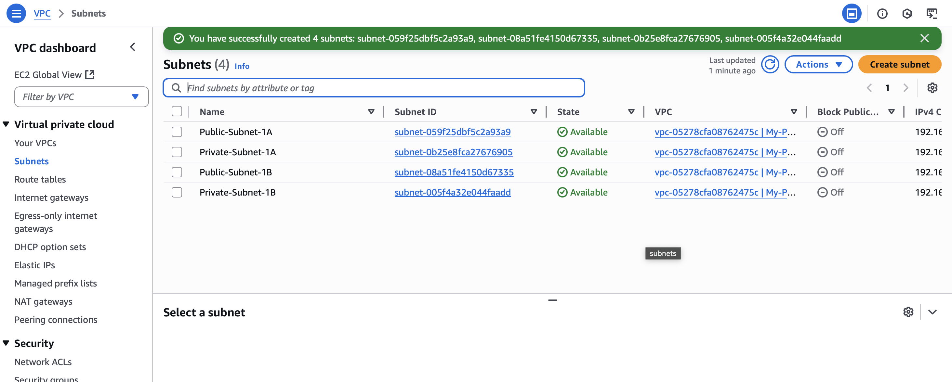
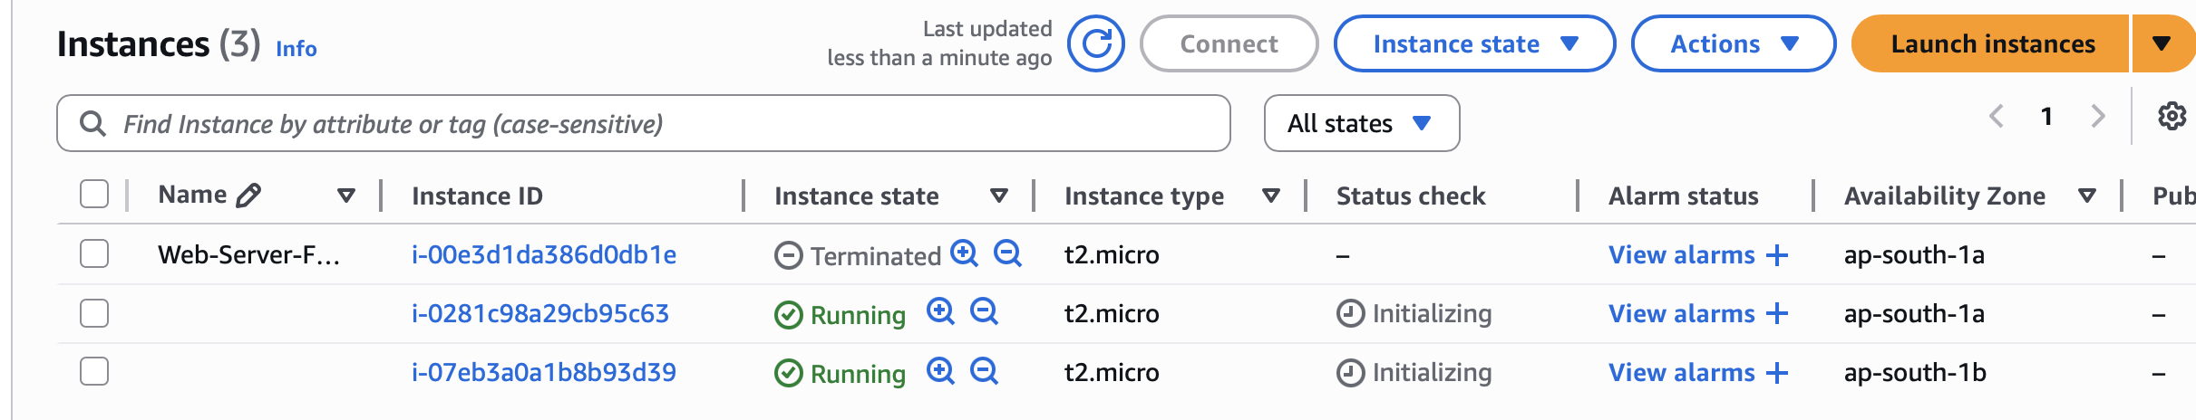
Elastic Compute Cloud (EC2):
1- Utilize EC2 instances to host the web application.
2- These instances will serve as the compute resources running the application, benefiting from AWS's secure, resizable compute capacity.

Slide 8
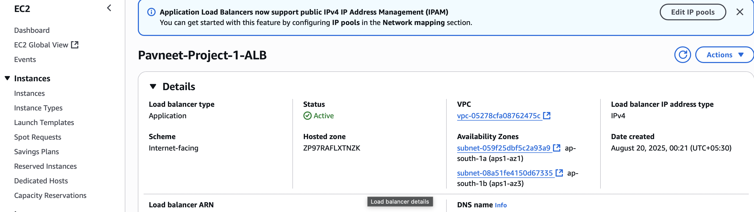
AWS Auto Scaling: Configure Auto Scaling to dynamically adjust the number of EC2 instances, ensuring that the application scales efficiently with demand.
Application Load Balancer (ALB): Utilize an ALB to distribute incoming traffic across multiple EC2 instances in different AZs, enhancing the fault tolerance and availability of the application.

Slide 9
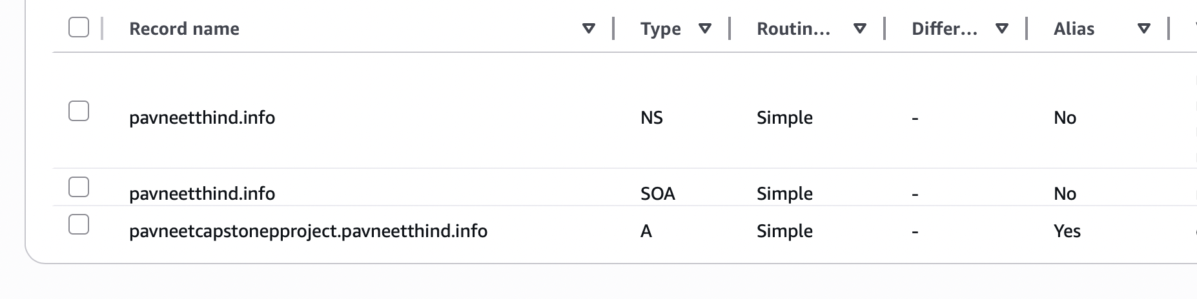
Route 53: Employ Route 53 for domain management and to route end-user requests to the application in a reliable and cost-effective manner.

Slide 10
Challenges encountered
Configuration Complexities
Setting up VPCs, subnets, routing tables, and security groups can get complicated.
Misconfigured security groups or IAM roles may lead to blocked traffic or excessive permissions.
Integration Problems with AWS Services
Ensuring smooth integration between ALB, EC2, EFS, Auto Scaling, and Route 53 often causes hiccups.
Example: EC2 instances might fail to mount EFS due to missing IAM policies or NFS misconfiguration.

Slide 11
Scalability Issues Under Load
Auto Scaling policies may not respond quickly enough to sudden traffic spikes.
Application session handling can break if sticky sessions aren’t configured properly on the ALB.
High Availability Considerations Across Multiple Azs
Deploying across multiple Availability Zones increases reliability, but introduces challenges like data synchronization delays and higher latency.
Ensuring EFS and databases are consistently available across AZs requires careful setup.

Slide 12
Troubleshooting & Solutions
Configuration Complexities
Issue: Misconfigured VPC subnets and overly restrictive security groups initially blocked traffic to EC2.
Solution: Reviewed routing tables and applied least-privilege security group rules. Documented all configurations to avoid conflicts.
Integration Problems with AWS Services
Issue: EC2 instances were unable to mount EFS due to missing IAM roles and NFS setup errors.
Solution: Attached correct IAM policies, updated mount targets in each AZ, and verified EFS connectivity with test scripts.

Slide 13
Scalability Issues Under Load
Issue: Auto Scaling group did not respond quickly enough to traffic spikes, causing slow response times.
Solution: Tuned Auto Scaling policies with lower CPU thresholds and shorter cooldown periods; added CloudWatch alarms for proactive scaling.
High Availability Across Multiple AZs
Issue: Load Balancer initially routed traffic unevenly and some AZs experienced latency.
Solution: Enabled cross-zone load balancing and tested failover scenarios to ensure smooth traffic distribution.

